Slide 1
Distributed Computer Systems
CT024-3-3-DCOMS and VE
Remote Method Invocation (RMI)

Slide 2
TOPIC LEARNING OUTCOMES
At the end of this topic, you should be able to:
1. Understanding of RPC
2. Understanding the stub and skeleton
3. Implementation of RMI

Slide 3
Contents & Structure
What is RPC?
Define what is RMI?
What are the steps involved in creating RMI?

Slide 4
Recap From Last Lesson
What are the security issues in DS?
List out the essential factors of security elements in DS
How to set secure password?

Slide 5
Remote Procedure Call (RPC)
The most common framework for newer protocols and for middleware
Used both by operating systems and by applications
NFS is implemented as a set of RPCs
DCOM, CORBA, Java RMI, etc., are just RPC systems
Fundamental idea: –
Server process exports an interface of procedures or functions that can be called by client programs
similar to library API, class definitions, etc.
Clients make local procedure/function calls
As if directly linked with the server process
Under the covers, procedure/function call is converted into a message exchange with remote server process

Slide 6
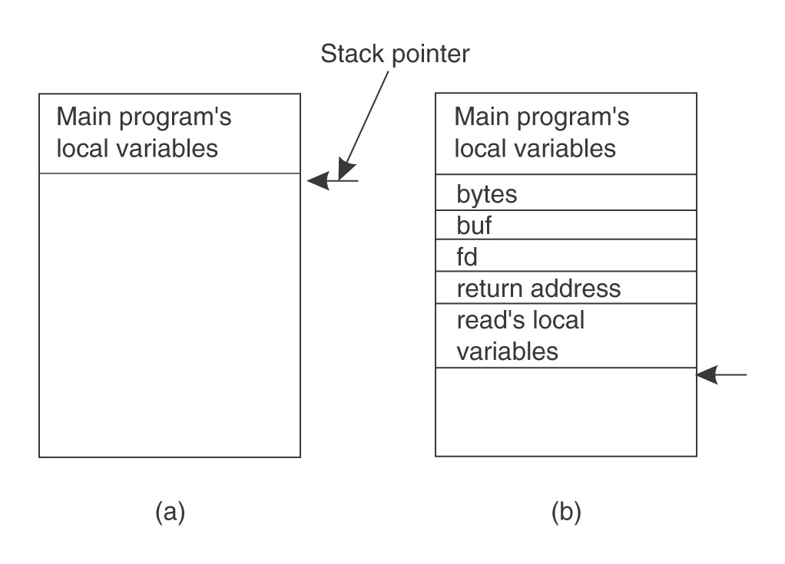
Ordinary procedure/function call
count = read(fd, buf, nbytes)

Slide 7
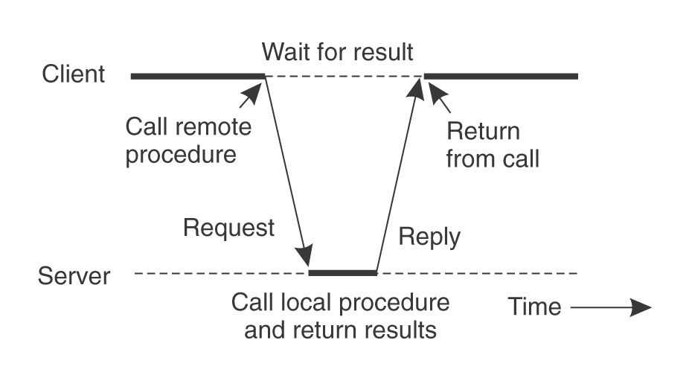
Would like to do the same if called procedure or function is on a remote server

Slide 8
Solution – a pair of stubs
Client-side stub
Looks like local server function
Same interface as local function
Bundles arguments into message, sends to server-side stub
Waits for reply, un-bundles results
returns

Slide 9
Server-side stub
Looks like local client function to server
Listens on a socket for message from client stub
Un-bundles arguments to local variables
Makes a local function call to server
Bundles result into reply message to client stub

Slide 10
Result
The hard work of building messages, formatting, uniform representation, etc., is buried in the stubs
Where it can be automated!
Client and server designers can concentrate on the semantics of application
Programs behave in familiar way

Slide 11
RPC Model
A server defines the service interface using an interface definition language (IDL)
the IDL specifies the names, parameters, and types for all client-callable server procedures
A stub compiler reads the IDL declarations and produces two stub functions for each server function
Server-side and client-side

Slide 12
RPC Model (continued)
Linking:–
Server programmer implements the service’s functions and links with the server-side stubs
Client programmer implements the client program and links it with client-side stubs
Operation:–
Stubs manage all of the details of remote communication between client and server

Slide 13
RPC Stubs
A client-side stub is a function that looks to the client as if it were a callable server function
I.e., same API as the server’s implementation of the function
A server-side stub looks like a caller to the server
I.e., like a hunk of code invoking the server function
The client program thinks it’s invoking the server
but it’s calling into the client-side stub
The server program thinks it’s called by the client
but it’s really called by the server-side stub
The stubs send messages to each other to make the RPC happen transparently (almost!)

Slide 14
Marshalling Arguments
Marshalling is the packing of function parameters into a message packet
the RPC stubs call type-specific functions to marshal or unmarshal the parameters of an RPC
Client stub marshals the arguments into a message
Server stub unmarshals the arguments and uses them to invoke the service function
on return:
the server stub marshals return values
the client stub unmarshals return values, and returns to the client program

Slide 15
Java Remote Object Invocation (RMI)
Overview of RMI
Java RMI allowed programmer to execute remote function class using the same semantics as local functions calls.
Local Machine (Client)
SampleServer remoteObject;
int s;
…
s = remoteObject.sum(1,2);
System.out.println(s);
Remote Machine (Server)
public int sum(int a,int b) {
return a + b;
}
1,2
3

Slide 16
The General RMI Architecture
The server must first bind its name to the registry
The client lookup the server name in the registry to establish remote references.
The Stub serializing the parameters to skeleton, the skeleton invoking the remote method and serializing the result back to the stub.

Slide 17
The Stub and Skeleton
A client invokes a remote method, the call is first forwarded to stub.
The stub is responsible for sending the remote call over to the server-side skeleton
The stub opening a socket to the remote server, marshaling the object parameters and forwarding the data stream to the skeleton.
A skeleton contains a method that receives the remote calls, unmarshals the parameters, and invokes the actual remote object implementation.

Slide 18
Remote Method Invocation
Remote method invocation(RMI) allow a java object to invoke method on an object running on another machine. RMI provide remote communication between java program. RMI is used for building distributed application.

Slide 19
Concept of RMI
A RMI application can be divided into two part, Client program and Server program. A Server program creates some remote object, make their references available for the client to invoke method on it. A Client program make request for remote objects on server and invoke method on them. Stub and Skeleton are two important object used for communication with remote object.

Slide 20
Stub and Skeleton
Stub act as a gateway for Client program. It resides on Client side and communicate with Skeleton object. It establish the connection between remote object and transmit request to it.
Skeleton object resides on server program. It is responsible for passing request from Stub to remote object.

Slide 21
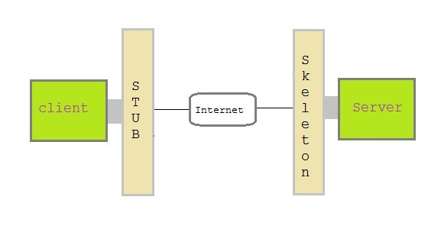
Stub and Skeleton

Slide 22
Creating a simple RMI application
Define a remote interface.
Implementing remote interface.
create and start remote application
create and start client application

Slide 23
Define a remote interface
A remote interface specifies the methods that can be invoked remotely by a client. Clients program communicate to remote interfaces, not to classes implementing it. To be a remote interface, a interface must extend the Remote interface of java.rmi package.

Slide 24
Remote Interface
import java.rmi.*;
public interface AddServerInterface extends Remote
{
public int sum(int a,int b);
}

Slide 25
Implementation of remote interface
For implementation of remote interface, a class must either extend UnicastRemoteObject or use exportObject() method of UnicastRemoteObject class.

Slide 26
import java.rmi.*;
import java.rmi.server.*;
public class Adder extends UnicastRemoteObject
implements AddServerInterface
{
Adder()throws RemoteException
{
super();
}
public int sum(int a,int b)
{
return a+b;
}
}

Slide 27
Create AddServer and host rmi service
You need to create a server application and host rmi service Adder in it.
This is done using rebind() method of java.rmi.Naming class.
rebind() method take two arguments, first represent the name of the object reference and second argument is reference to instance of Adder

Slide 28
import java.rmi.*;
import java.rmi.registry.*;
public class AddServer
{
public static void main(String args[])
{ try
{
AddServerInterface addService=new Adder();
Naming.rebind("AddService",addService); //addService object
is hosted with name AddService.
}
catch(Exception e)
{
System.out.println(e);
}
}
}

Slide 29
Create Client Application
Client application contains a java program that invokes the lookup() method of the Naming class.
This method accepts one argument, the rmi URL and returns a reference to an object of type AddServerInterface. All remote method invocation is done on this object.

Slide 30
import java.rmi.*;
public class Client
{
public static void main(String args[])
{
try
{
AddServerInterface st=(AddServerInterface)Naming.lookup("rmi://"+args[0]+"/AddService");
System.out.println(st.sum(25,8));
}
catch(Exception e)
{
System.out.println(e);
}
}
}

Slide 31
Execution
Compile all the files using javac
Start rmi registry
Run server
Run client
Output is : 33

Slide 32
Write a RMI application to reverse the given string .Write all interfaces and required classes
import java.rmi.*; public interface StrRev extends Remote { public String reverse(String str) throws RemoteException; }

Slide 33
import java.rmi.*; import java.rmi.server.*; import java.util.*; public class StrRev_Impli extends UnicastRemoteObject implements StrRev { public StrRev_Impli() throws RemoteException {} public String reverse(String str) throws RemoteException { String str1=""; for(int i=str.length()-1;i>=0;i--) str1=str1+str.charAt(i); return (str1); } }

Slide 34
import java.rmi.*; import java.net.*; public class StrRev_Server { public static void main(String args[]) { try { StrRev_Impli strimpli=new StrRev_Impli(); Naming.rebind("RmiReverse",strimpli); } catch(Exception ex){} } }

Slide 35
import java.io.*; import java.rmi.*; import java.net.*; public class StrRev_Client { public static void main(String args[]) { try { String url="rmi://127.0.0.1/RmiReverse"; StrRev strf=(StrRev)Naming.lookup(url); BufferedReader br=new BufferedReader(new InputStreamReader(System.in)); System.out.println("Enter String to reverse : "); String str=br.readLine(); System.out.println("Reverse of entered string is "+strf.reverse(str)); } catch(Exception ex){} } }

Slide 36
Write a RMI application to check whether the given number is Prime or not . Write all interfaces and required classes.
import java.rmi.*; public interface Prime extends Remote { public int check_prime(int no) throws RemoteException; }

Slide 37
import java.rmi.*; import java.net.*; public class Prime_server { public static void main(String args[]) { try { Prime_Impli primpli=new Prime_Impli(); Naming.rebind("RmiPrime",primpli); } catch(Exception ex){} } }

Slide 38
import java.io.*; import java.rmi.*; import java.net.*; public class Prime_client { public static void main(String args[]) { try { String url="rmi://127.0.0.1/RmiPrime"; Prime intf=(Prime)Naming.lookup(url); BufferedReader br=new BufferedReader(new InputStreamReader(System.in)); System.out.println("Enter No : "); int no=Integer.parseInt(br.readLine()); int x=intf.check_prime(no); if(x==0) System.out.println(no+" is prime number"); else System.out.println(no+" is not prime number"); } catch(Exception ex){} } }

Slide 39
Steps for Developing an RMI System
1. Define the remote interface
2. Develop the remote object by implementing the remote interface.
3. Develop the client program.
4. Compile the Java source files.
5. Generate the client stubs and server skeletons.
6. Start the RMI registry.
7. Start the remote server objects.
8. Run the client

Slide 40
Step 1: Defining the Remote Interface
To create an RMI application, the first step is the defining of a remote interface between the client and server objects.
/* SampleServer.java */
import java.rmi.*;
public interface SampleServer extends Remote
{
public int sum(int a,int b) throws RemoteException;
}

Slide 41
Step 2: Develop the remote object and its interface
The server is a simple unicast remote server.
Create server by extending java.rmi.server.UnicastRemoteObject.
The server uses the RMISecurityManager to protect its resources while engaging in remote communication.
/* SampleServerImpl.java */
import java.rmi.*;
import java.rmi.server.*;
import java.rmi.registry.*;
public class SampleServerImpl extends UnicastRemoteObject
implements SampleServer
{
SampleServerImpl() throws RemoteException
{
super();
}

Slide 42
Step 2: Develop the remote object and its interface
Implement the remote methods
/* SampleServerImpl.java */
public int sum(int a,int b) throws RemoteException
{
return a + b;
}
}
The server must bind its name to the registry, the client will look up the server name.
Use java.rmi.Naming class to bind the server name to registry. In this example the name call “SAMPLE-SERVER”.
In the main method of your server object, the RMI security manager is created and installed.

Slide 43
Step 2: Develop the remote object and its interface
/* SampleServerImpl.java */
public static void main(String args[])
{
try
{
System.setSecurityManager(new RMISecurityManager());
//set the security manager
//create a local instance of the object
SampleServerImpl Server = new SampleServerImpl();
//put the local instance in the registry
Naming.rebind("SAMPLE-SERVER" , Server);
System.out.println("Server waiting.....");
}
catch (java.net.MalformedURLException me) {
System.out.println("Malformed URL: " + me.toString()); }
catch (RemoteException re) {
System.out.println("Remote exception: " + re.toString()); }
}

Slide 44
Step 3: Develop the client program
In order for the client object to invoke methods on the server, it must first look up the name of server in the registry. You use the java.rmi.Naming class to lookup the server name.
The server name is specified as URL in the from ( rmi://host:port/name )
Default RMI port is 1099.
The name specified in the URL must exactly match the name that the server has bound to the registry. In this example, the name is “SAMPLE-SERVER”
The remote method invocation is programmed using the remote interface name (remoteObject) as prefix and the remote method name (sum) as suffix.

Slide 45
Step 3: Develop the client program
import java.rmi.*;
import java.rmi.server.*;
public class SampleClient
{
public static void main(String[] args)
{
// set the security manager for the client
System.setSecurityManager(new RMISecurityManager());
//get the remote object from the registry
try
{
System.out.println("Security Manager loaded");
String url = "//localhost/SAMPLE-SERVER";
SampleServer remoteObject = (SampleServer)Naming.lookup(url);
System.out.println("Got remote object");
System.out.println(" 1 + 2 = " + remoteObject.sum(1,2) );
}
catch (RemoteException exc) {
System.out.println("Error in lookup: " + exc.toString()); }
catch (java.net.MalformedURLException exc) {
System.out.println("Malformed URL: " + exc.toString()); }
catch (java.rmi.NotBoundException exc) {
System.out.println("NotBound: " + exc.toString());
}
}
}

Slide 46
Step 4 & 5: Compile the Java source files & Generate the client stubs and server skeletons
Assume the program compile and executing at elpis on ~/rmi
Once the interface is completed, you need to generate stubs and skeleton code. The RMI system provides an RMI compiler (rmic) that takes your generated interface class and procedures stub code on its self.
elpis:~/rmi> set CLASSPATH=”~/rmi”
elpis:~/rmi> javac SampleServer.java
elpis:~/rmi> javac SampleServerImpl.java
elpis:~/rmi> rmic SampleServerImpl
elpis:~/rmi> javac SampleClient.java

Slide 47
Step 6: Start the RMI registry
The RMI applications need install to Registry. And the Registry must start manual by call rmiregisty.
The rmiregistry us uses port 1099 by default. You can also bind rmiregistry to a different port by indicating the new port number as : rmiregistry <new port>
elpis:~/rmi> rmiregistry
Remark: On Windows, you have to type in from the command line:
> start rmiregistry

Slide 48
Steps 7 & 8: Start the remote server objects & Run the client
Once the Registry is started, the server can be started and will be able to store itself in the Registry.
Because of the grained security model in Java 2.0, you must setup a security policy for RMI by set java.security.policy to the file policy.all
elpis:~/rmi> java –Djava.security.policy=policy.all SampleServerImpl
elpis:~/rmi> java –Djava.security.policy=policy.all SampleClient

Slide 49
Review Questions
Define what is RPC?
Define what is RMI?
What are the necessary steps involved in creating RMI application?

Slide 50
Summary / Recap of Main Points
RPC Model
RPC Stubs
Marshalling Arguments
RMI

Slide 51
What To Expect Next Week
In Class
Preparation for Class
Write a program in RMI to perform addition of 2 numbers.
Socket Programming

